Slide 1

Online Book Store Analysis SQL-Project
By - Isha Pandey

Slide 2
Some Basic And Advance Insights

Slide 3
Project Overview
Objective:
◆ Analyze a bookstore database using SQL
◆ Extract business insights from customer, order, and book data
Dataset Contains:
◆ Books
◆ Customers
◆ Orders
Tools Used:
◆ MYSQL

Slide 4

Database Schema & Table Creation
Books Table | Customers Table | Orders Table
CREATE TABLE Books ( Book_ID SERIAL PRIMARY KEY, Title VARCHAR(100), Author VARCHAR(100), Genre VARCHAR(50), Published_Year INT, Price NUMERIC(10, 2), Stock INT ); | CREATE TABLE Customers Customer_ID SERIAL PRIMARY KEY, Name VARCHAR(100), Email VARCHAR(100), Phone VARCHAR(15), City VARCHAR(50), Country VARCHAR(150) ); | CREATE TABLE Orders ( Order_ID SERIAL PRIMARY KEY, Customer_ID INT REFERENCES Customers(Customer_ID), Book_ID INT REFERENCES Books(Book_ID), Order_Date DATE, Quantity INT, ); Total_Amount NUMERIC(10,2));

Slide 5
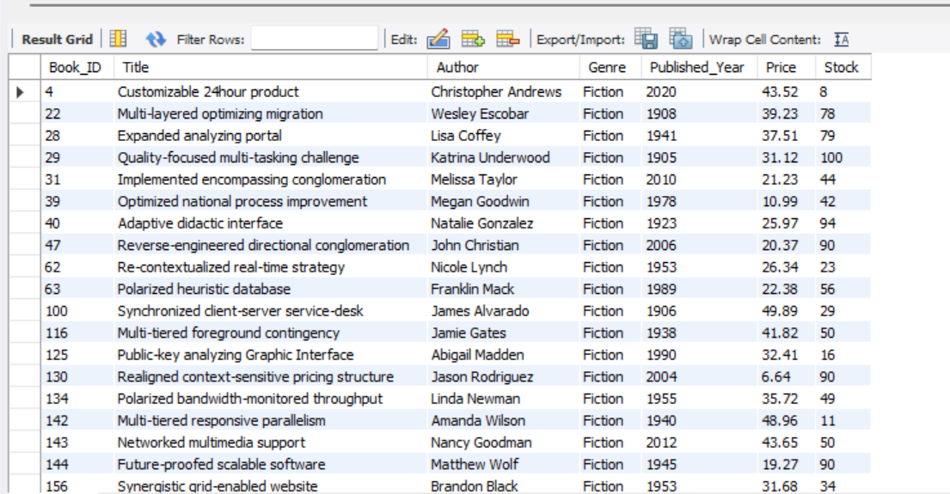
1) Retrieve all books in the "Fiction" genre: SELECT * FROM Books WHERE Genre='Fiction';

Slide 6
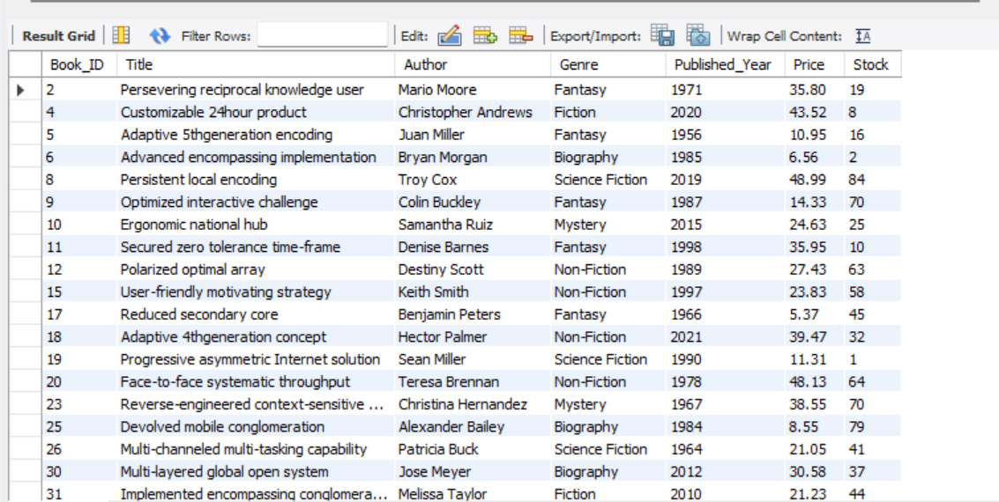
2) Find books published after the year 1950: SELECT * FROM Books WHERE Published_year>1950;

Slide 7
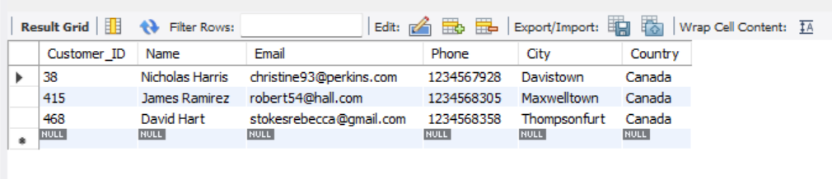
3) List all customers from the Canada: SELECT * FROM Customers WHERE country='Canada';

Slide 8
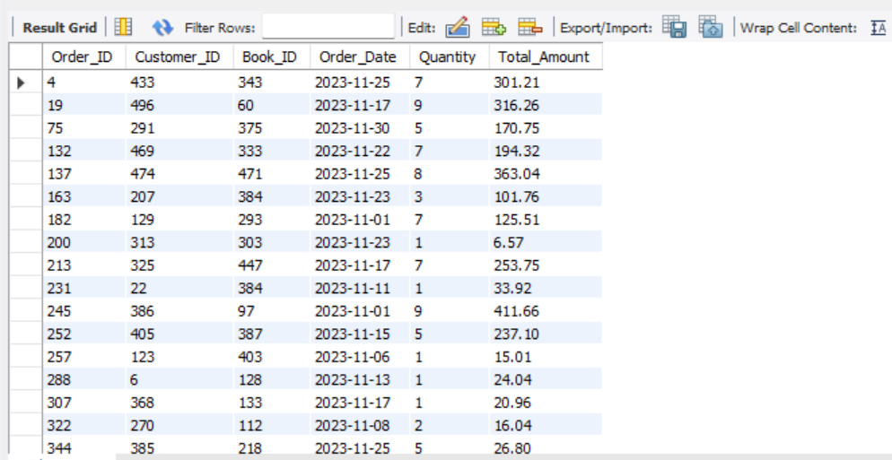
4) Show orders placed in November 2023: SELECT * FROM Orders WHERE order_date BETWEEN '2023-11-01' AND '2023-11-30';

Slide 9
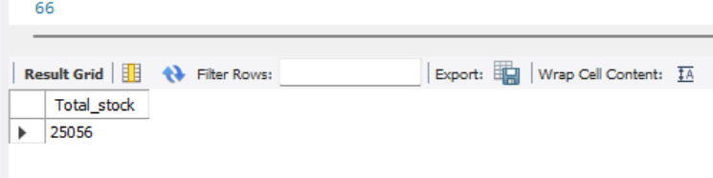
5) Retrieve the total stock of books available: SELECT SUM(stock) AS Total_Stock From Books;

Slide 10
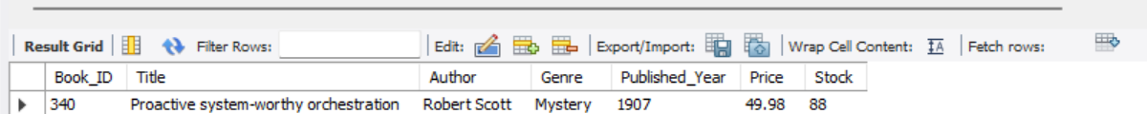
6) Find the details of the most expensive book: SELECT * FROM Books ORDER BY Price DESC LIMIT 1;

Slide 11
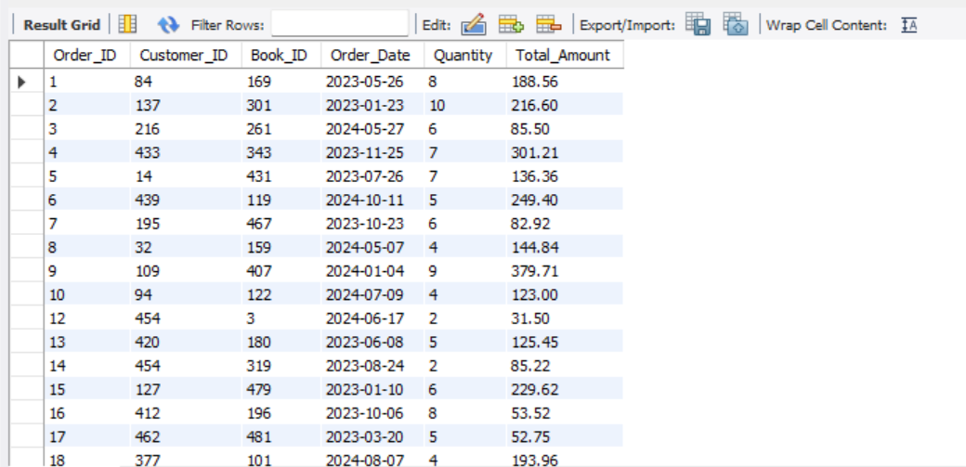
7) Show all customers who ordered more than 1 quantity of a book: SELECT * FROM Orders WHERE quantity>1;

Slide 12
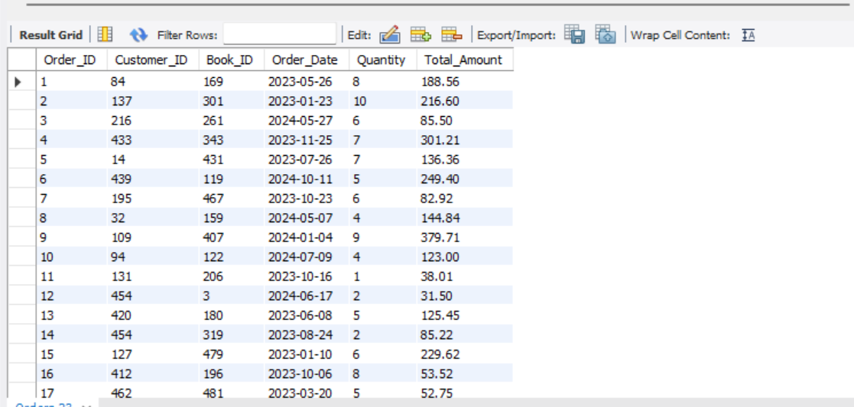
8) Retrieve all orders where the total amount exceeds $20: SELECT * FROM Orders WHERE total_amount>20;

Slide 13
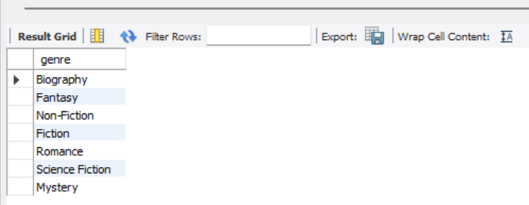
9) List all genres available in the Books table: SELECT DISTINCT genre FROM Books;

Slide 14
10) Find the book with the lowest stock: SELECT * FROM Books ORDER BY stock LIMIT 1;

Slide 15
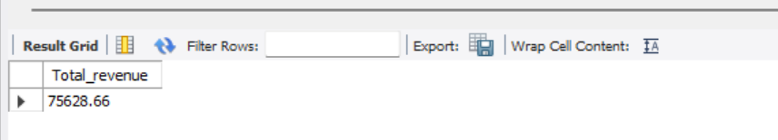
11) Calculate the total revenue generated from all orders: SELECT SUM(total_amount) As Revenue FROM Orders;

Slide 16
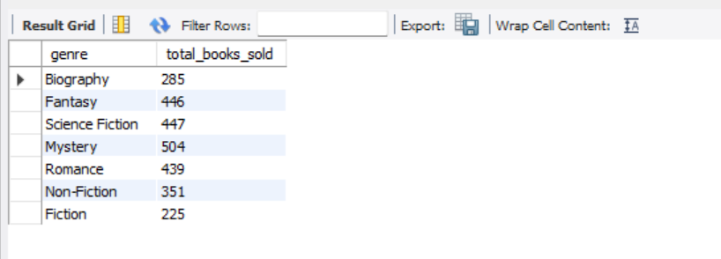
12) Retrieve the total number of books sold for each genre: SELECT b.Genre, SUM(o.Quantity) AS Total_Books_sold FROM Orders o JOIN Books b ON o.book_id = b.book_id GROUP BY b.Genre;

Slide 17

13) Find the average price of books in the "Fantasy" genre: SELECT AVG(price) AS Average_Price FROM Books WHERE Genre = 'Fantasy';

Slide 18
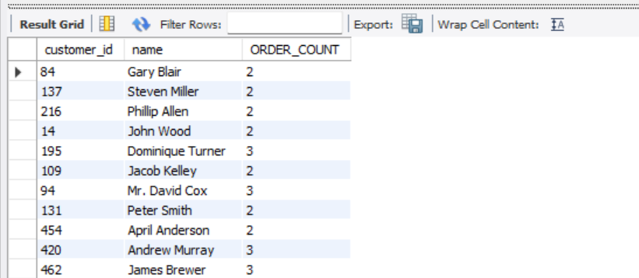
14) List customers who have placed at least 2 orders: SELECT o.customer_id, c.name, COUNT(o.Order_id) AS ORDER_COUNT FROM orders o JOIN customers c ON o.customer_id=c.customer_id GROUP BY o.customer_id, c.name HAVING COUNT(Order_id) >=2;

Slide 19
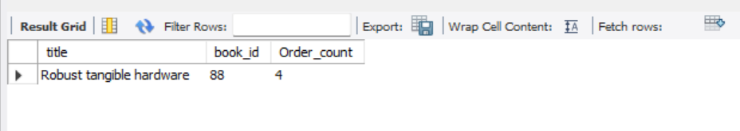
15) Find the most frequently ordered book: SELECT o.Book_id, b.title, COUNT(o.order_id) AS ORDER_COUNT FROM orders o JOIN books b ON o.book_id=b.book_id GROUP BY o.book_id, b.title ORDER BY ORDER_COUNT DESC LIMIT 1;

Slide 20
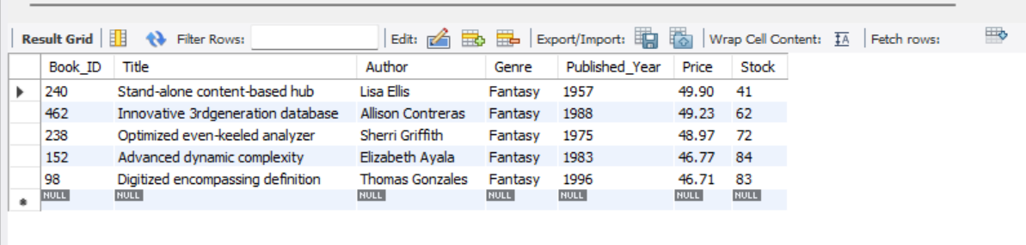
16) Show the top 3 most expensive books of 'Fantasy' Genre : SELECT * FROM books WHERE genre ='Fantasy' ORDER BY price DESC LIMIT 3;

Slide 21
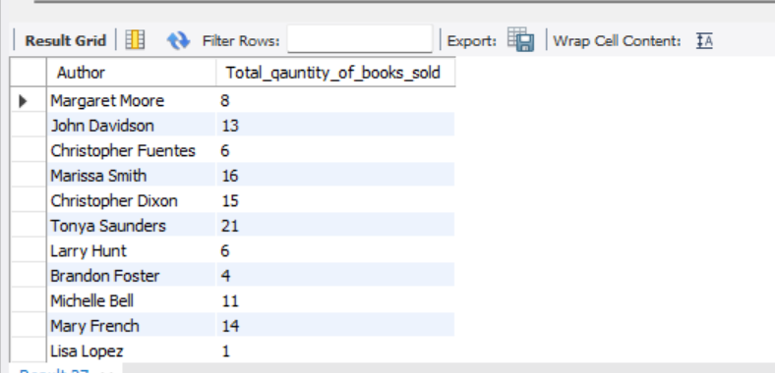
17) Retrieve the total quantity of books sold by each author: SELECT b.author, SUM(o.quantity) AS Total_Books_Sold FROM orders o JOIN books b ON o.book_id=b.book_id GROUP BY b.Author;

Slide 22
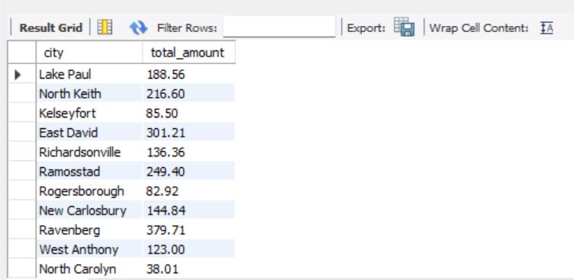
18) List the cities where customers who spent over $30 are located: SELECT DISTINCT c.city, total_amount FROM orders o JOIN customers c ON o.customer_id=c.customer_id WHERE o.total_amount > 30;

Slide 23
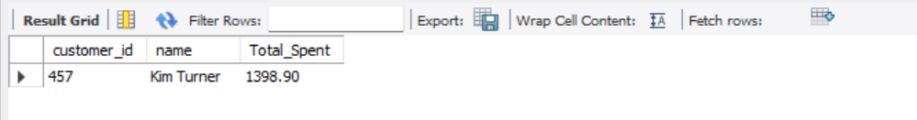
19) Find the customer who spent the most on orders: SELECT c.customer_id, c.name, SUM(o.total_amount) AS Total_Spent FROM orders o JOIN customers c ON o.customer_id=c.customer_id GROUP BY c.customer_id, c.name ORDER BY Total_spent Desc LIMIT 1;

Slide 24
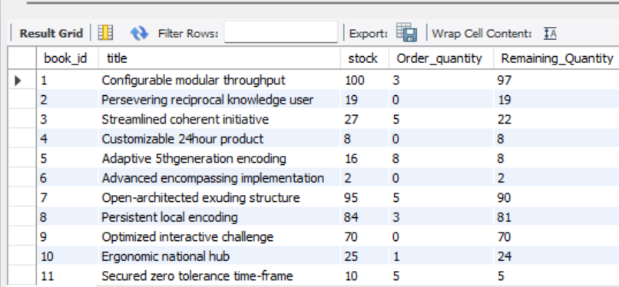
20) Calculate the stock remaining after fulfilling all orders: select b.book_id, b.title, b.stock, coalesce(sum(o.quantity),0) as order_quantity, b.stock- coalesce(sum(o.quantity),0) as remaining_quantity from books b left join orders o on b.book_id=o.book_id group by b.book_id order by b.book_id;

